Slide 1
Using Players’ Gameplay Action-Decision Profiles to Prescribe Training
Reducing Training Costs with Serious Games Analytics
Christian Sebastian Loh & I-Hung Li
Virtual Environment & Reality Lab (V-Lab)
College of Education & Human Services Southern Illinois University
Carbondale, IL, USA.

Slide 2
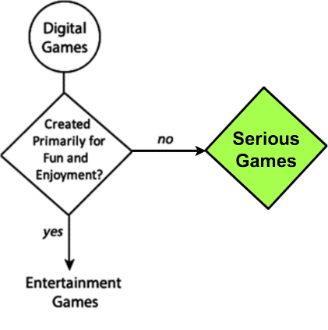
Games VS. Serious Games
Serious Games : Non-entertainment games (also, games4change, games4health, games for training, game-based learning.)
Serious Games are TOOLS
Can be used for many purposes:
human performance training (workplace),
game-based learning (education)
policy change (social)
Need to maximize values of SG for clients!!

Slide 3
More TERMS
Acton-Decision Data : Most player generated in-game data are consisted of actions (result of decision-making process), hence: action-decision data
Profiles : Binning of action-decision data into groups based on certain ‘identifying features’.
Training : especially that of human performance (AIM: improve human performance over time).
Prescribe : When to _____, how much to _____, what to ____ (procedure to follow), OR NOT
Reducing training cost : A desired outcome for many training organizations (maximizing values of serious games for your customers!)
VS. Monetization (maximizing value of serious games for the developing company)
Serious Games Analytics : creating insights for performance measurement, assessment, and improvement (also include information visualization and predictive analytics)

Slide 4
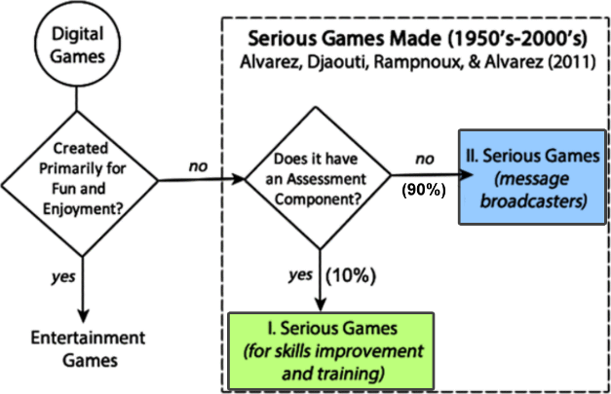
Games VS. Serious Games
S.G. -- tools for human performance training (workplace) and game-based learning (education)
Serious Games Analytics – predict, measure, assess, and improve performance; as well as reporting/visualization
How about diagnostics to ‘prescribe training’
Who should receive training?
When to provide training?
How much content should be included or withheld?

Slide 5
Maximizing the Value of Player Data
Motivation: Use Serious Games Analytics to reduce training cost.
Improve performance (reduce cost) through Serious Game Analytics.
Why?
25% of Global Fortune 500 companies use serious games for training.
Information Trails (our system) contains BOTH telemetric data capturing and visualization
Performance Report Tracing assistant (PeTRA): ad hoc (real-time) and post hoc (after action) reporting

Slide 6
Performance and “Performance Gap”
Before improving performance, you must first understand performance gap.
According to literature in the field of Instructional Design & Technology, a Performance Gap is caused by the combination of three factors:
Only the Knowledge Gap is bridgeable through training, but not the Resource and Motivation Gaps.

Slide 7
Skill Acquisitions towards Expertise
Five-level Model of Expertise (Dreyfus & Dreyfus, 1980)
Only the first three levels can be achievable through training
Expert and Master are only attainable through long period of deliberate practice (up to 10 yrs/10 000 hrs)

Slide 8
the needs of ORGANIZATIONS FOR EXPERTISE
Majority of workforce in the lower levels: Novice, Competent, and Proficient.
Expert/ Master ‘role models’ are very valuable but RARE assets → need time to grow
New hires enter at absolute Novice level to some degrees of Proficient.
Deliberate practice is severely lacking in organizational (F2F) training → achievable through technology-enhanced training (e.g., serious games, simulation, etc).

Slide 9
WHY Prescribe Training?
Identifying who, what, and when to train, or not to train.
Evidence-based (visualization) training prescriptions
Three training outcomes:
Under-training puts organizations at high risk (workers’ mistakes → liabilities)
Just-right training (common sense approach → but how much is just right?)
Over-training (higher cost → Seriously, why?)

Slide 10
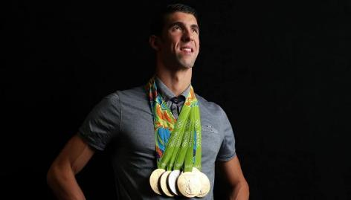
WHY PRESCRIBE OVER-TRAINING?
Research shown Over-training is necessary to:
Achieve automaticity (efficiency and quality assurance)
Maintain adequate performance during high-stress situations
Athletes (Olympics)
Pilots (emergency landing, e.g. Sully)
First Responders (disaster training), Surgeons, etc.
Analytic-driven training prescription is an untapped area, lots of research (opportunities) needed

Slide 11
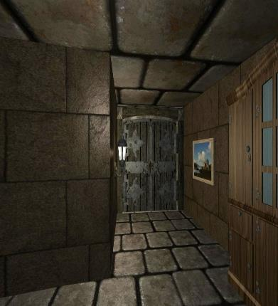
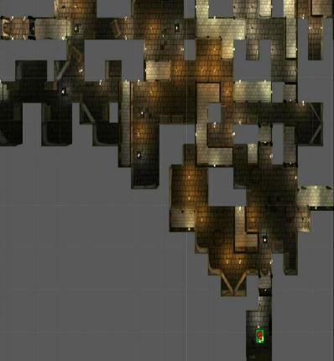
Information Trails
Loh, Anantachai, Byun, & Lenox (2007)
Gameplay action-decisions data (Course of Actions)
Performance Tracing Report Assistant (PeTRA)
Telemetry
Visualized
Data stored in remote database
Notes:
This is our information trail frameworks, which includes Game data collection (telemetry) method.
And another intendent program called PeTra (Performance Tracking Report assistant) to visualize the data.

Slide 12
Data telemetry
Game Play (capturing COAs) …….….. Information Trails (visualization)
Notes:
Here is a short video clip that briefly demonstrate the information trail frameworks.
On the left is the game play session and on the right is the petra (which is our visualization program).
Okay, lets see how it works. (play)
(end) as you can see, while player exploring in the game world, we can track their actions (or game events) and visualize them by using petra.

Slide 13
Similarity Measures
Loh & Sheng (2013, 2014)
Please see our other paper on how this can be done (Loh & Sheng, 2013; 2014).
Competency is characterized by an observable and demonstratable course of actions (COAs) during problem-solving (Dreyfus & Dreyfus, 1980).
Steps:
Traced players’ Course of Actions (i.e., gameplay action-decision data) telemetrically
Converted COAs into strings for similarity comparison
Pairwise comparison: Players (any levels) against the Expert baseline (ideal route)
Expert can be anyone you name (depending on your purpose)
Notes:
please…
According to Dreyfus and Dreyfus, Com…………
Which is the data we collected from previous demo.
To approach this, we have follow the steps.
First. Second, third, we perform…

Slide 14
PLAYERS’ Course of Actions (COA)
Loh & Sheng (2013, 2014)
U | V | W | X | Y
P | Q | R | S | T
K | L | M | N | O
F | G | H | I | J
A | B | C | D | E
End
Convert players’ movement to COAs:
Expert (Ideal route):
ABGMNSY
Player (novice/unknown, extra movements):
ABHCIHNIOTY
Start
Notes:
So how do we get player’s coa, in this example, we have two routes, we define blue as expert route and orange as player’s route.
Then we code their route and get the COAs string. ABG… ABH…

Slide 15
DIFFERENTIATING EXPERT NOVICE BY Similarity
Loh & Sheng (2013, 2014)
Pairwise string similarities comparison (in our study, Cosine similarity)
Similarity coefficient (ranges from 0 – 1, or, 0% – 100%)
value of 1: is identical to the expert/ideal route.
value of 0: furthest distance (or, most dissimilar) from expert route.
Further Readings: Additional similarities (Dice, Jaccard, etc), see Loh & Sheng (2013, 2014)
Efficiency comparison of 5 similarities, see Loh, Li, & Sheng, 2016
Notes:
In this study, we used cosine similarity as our major index.
You can also choose different similarity indices, please refer to our other studies.
The Similarity coefficient … ranges…
Value 1 or 100% means, or proficient
While 0 or 0% means, most dissimilar from expert, or novice.

Slide 16
WHAT IF: MULTIPLE EXPERTS’ ROUTES?
Please see our other paper (Loh & Sheng, 2014)
Sometimes, multiple experts may be present in a training scenarios.
You cannot “Average” expertise performance → it is no longer expertise.
Instead of 1 (player) to 1 (expert) similarity comparison, players’ routes need to be compared to multiple expert routes simultaneously.
Loh & Sheng (2014) developed a method called Maximum Similarity Indices (MSI) to compensate for this situation to obtain players’ ‘true’ similarity score.

Slide 17
Method
In-house game (Unity3D Maze)
16 participants (student volunteers)
Two critical routes, both are ‘correct’
RouteA – Longer
RouteB – Shorter, but with obstacle
“Pressure Plate” puzzle (take time to solve, but yield better long-term performance)
Notes:
In this study, we created a dudgeon style maze and first person perspective.
We have 16 college student volunteers.
The only objective in this game is to exit the maze as fast as you can, they have 1 hour, and play as many rounds as they want.
There are two critical routes can lead player to the exit.
Route A…
Route B…we put an obstacle.

Slide 18
Long vs. short (critical) route

Slide 19
Method
In-house game (Unity3D Maze)
16 participants (student volunteers)
Two critical routes, both are ‘correct’
RouteA – Longer
RouteB – Shorter, but with obstacle
“Pressure Plate” puzzle (take time to solve, but yield better long-term performance)
R to calculate Cosine similarity : “stringdist” package (van der Loo, 2006).
Maximum Similarity Index (MSI) needed for some profiles.
Visualization of COAs reveal three patterns of problem-solving strategies
We name this Gameplay Action-Decision (GAD) profiles.
Notes:
We then used R and a package called “stringdist” to calculate cosine similarity.
We also applied MSI for some profiles.
3. Read…

Slide 20
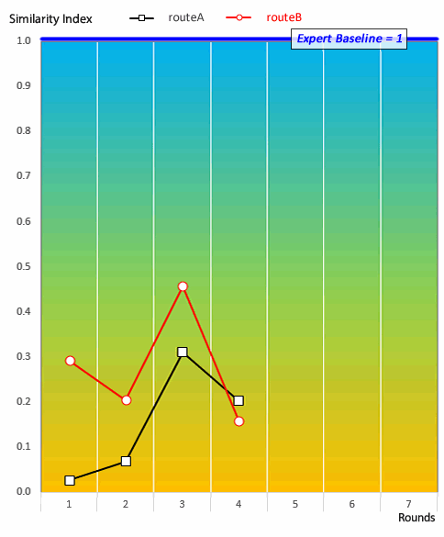
Game Action-Decision Profile 3: Quitter
Players who quit in less than 5 rounds.
Notes:
Dr Loh

Slide 21
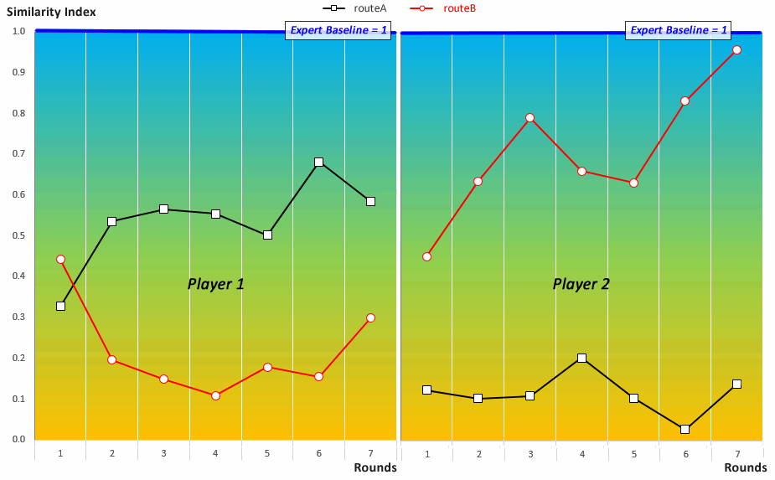
Game Action-Decision Profiles: Fulfiller

Slide 22
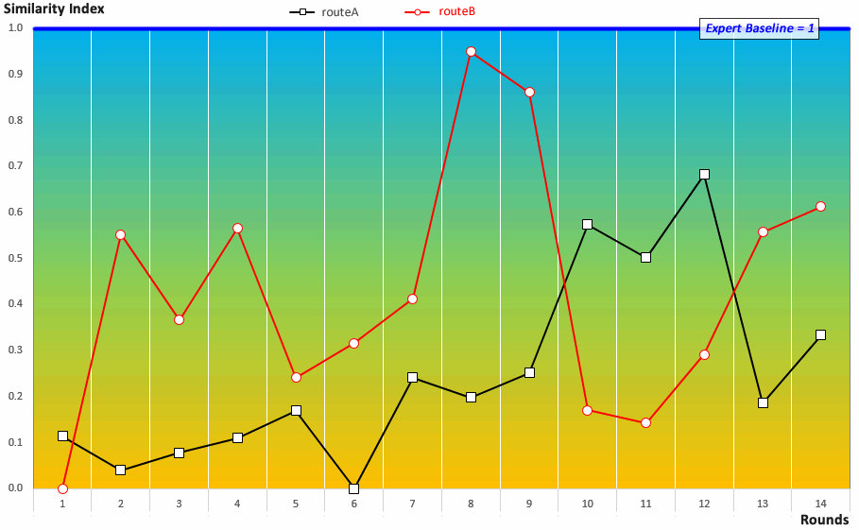
Game Action-Decision Profiles: Explorer

Slide 23
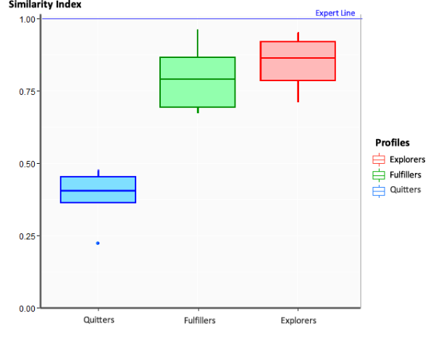
Performance differences by Profiles
t-test (α-level = 0.01), difference between three groups.
Statistically significant difference between Quitters and the two other profiles (p < 0.0001 for both cases).
No detectable statistically significant difference between the Explorers and Fulfillers (p = 0.805).
Performance/similarity scores:
Quitters (M = 0.399, SD = 0.068)
Fulfillers (M = 0.794, SD = 0.117)
Explorers (M = 0.846, SD = 0.108)
The highest score (0.959) belonged to a Fulfiller.

Slide 24
Contributions OF GAD PROFILES
Gameplay Action-Decision (GAD) profiling is data-driven and evidence-based
GAD profiles can be used to visualize how people make decisions in situ virtual training habitats
Open ways to decision-making and training research using similarity in game data science for corporate use → Prescribing Corrective, Regular, Over-Training
Maximizing player value in gameplay data through deliberate practice:
Increase proficiency under normal circumstances
Maintain adequate performance under high-stress situations (e.g., disaster training).
Encourage workers to learn new decision-making strategy (Fulfiller⬄Explorer)

Slide 25
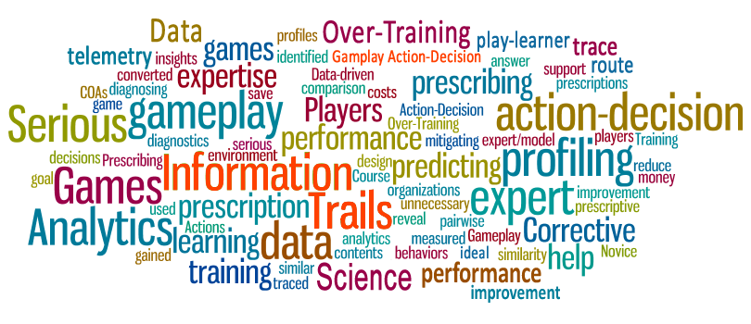
Conclusion
Many potential applications for Gameplay Action-Decision (GAD) profiling, reducing training cost is just one obvious application in training performance improvement.
Notes:
Future research can possibly inform:
which surgeons are prone to stress during surgical operations
which pilots are less fit to perform Trans-Atlantic flights
which soldiers are better suited for training as Reconnaissance, Medics, and others.

Slide 27
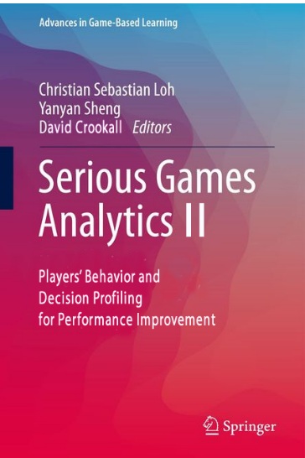
Serious Games Analytics II (2018) -- Call for Chapter
Behavioral & Decision Analytics Profiling for Performance Improvement
Military, Healthcare, and Business training industry
(Serious) game design improvement / monetization
Behavioral and procedural learning / training (e.g., sports, surgery, rehabilitation, game-based training)
Prescription of over-training, corrective training
Cross profile training
Methodologies and Applications
Identifying users’ action-behaviors and decision-making information
Modeling temporal behavior and decision-making behavior
Efficient techniques for online/real-time behavioral processing
http://www.csloh.com/SEGA

